Slide 1
This work is licensed under a Creative Commons Attribution-NonCommercial 2.0 Generic (CC BY-NC 2.0) International License
Module 1 - Planning Your Teaching

Slide 3
VIRTUAL CLASSROOM
GROUND RULES
AUDIO
Mute yourself when not talking
REACTION
Use reactions to express yourself
LIVE
Ongoing comments and questions in chat
WEBCAM
Leave it on if possible

Slide 4
Selecting digital resources
To access quality content, it is necessary to conduct quality research beforehand. (Digitalad p.15) To find quality tools, you can also access quality repositories, e.g. e-Pool
When selecting digital resource for your teaching, it is important to:
consider learning context and learning objective
critically evaluate the credibility and reliability of digital sources and resources (DigCompEdu p.44)

Slide 5
e-Pool
A bank of digital resources for teaching and learning
Recommended tools
Resources for educators
Resources for learners
Useful search tool to find a resource for teaching and learning
https://sites.google.com/view/e-pool/home

Slide 6
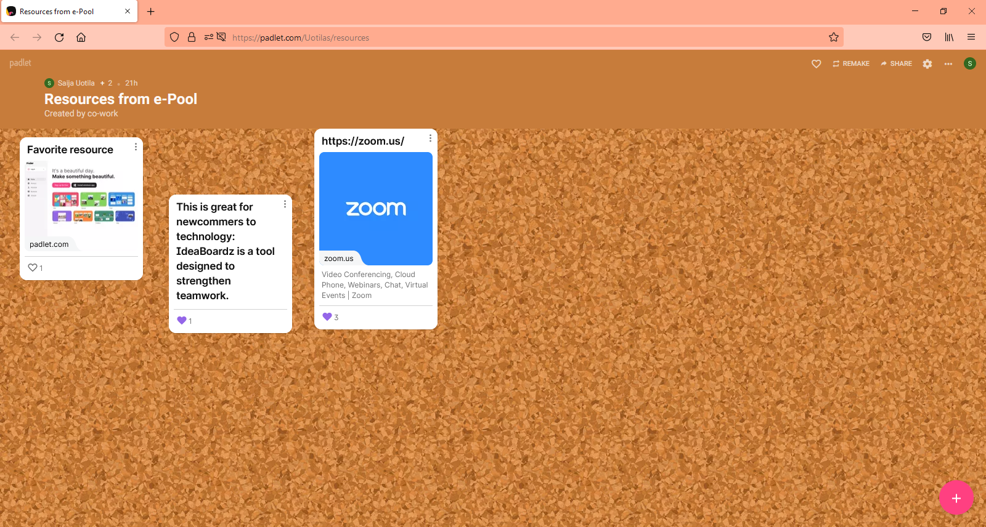
TOOL: Padlet
Online notice board
Can be used by teachers and learners
Teacher can create online boards with free account
Learners don’t need accounts
Access through link
You can choose your board's format
Posts appear differently on different formats

Slide 7
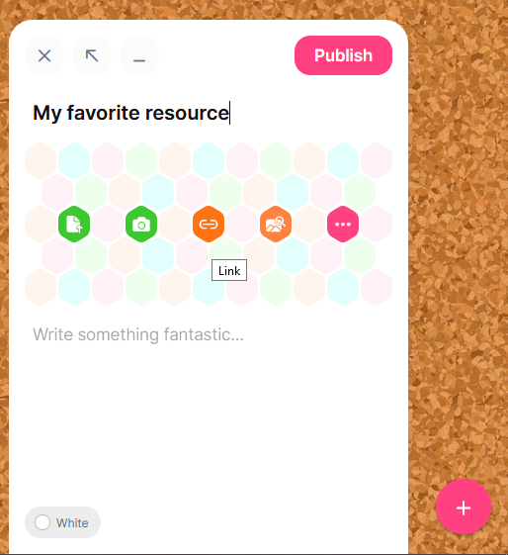
Practice: Post in Padlet
Choose two resources from the e-Pool
Choose resources that you could use with your learners
Post them in the Padlet link
If same resource is already posted, give it a like
Click to add new post
Reflect:
Why did you pick these resources?

Slide 8
Mentimeter
Web-based program
Live polls
Quizzes
Word clouds
Questions and answers
https://www.mentimeter.com/
Educator creates account and content
Learner access content through https://www.menti.com/
Educator provides code

Slide 9
Post-course assignment
Complete assessment quiz
Link will be sent to you by email
Create Mentimeter account
Create quizz or poll for your learners
Use images and text
Review Curriculum Development
Evolving model p. 21
Example of how to design a curriculum for basic skills
Link will be sent to you by email

Slide 10
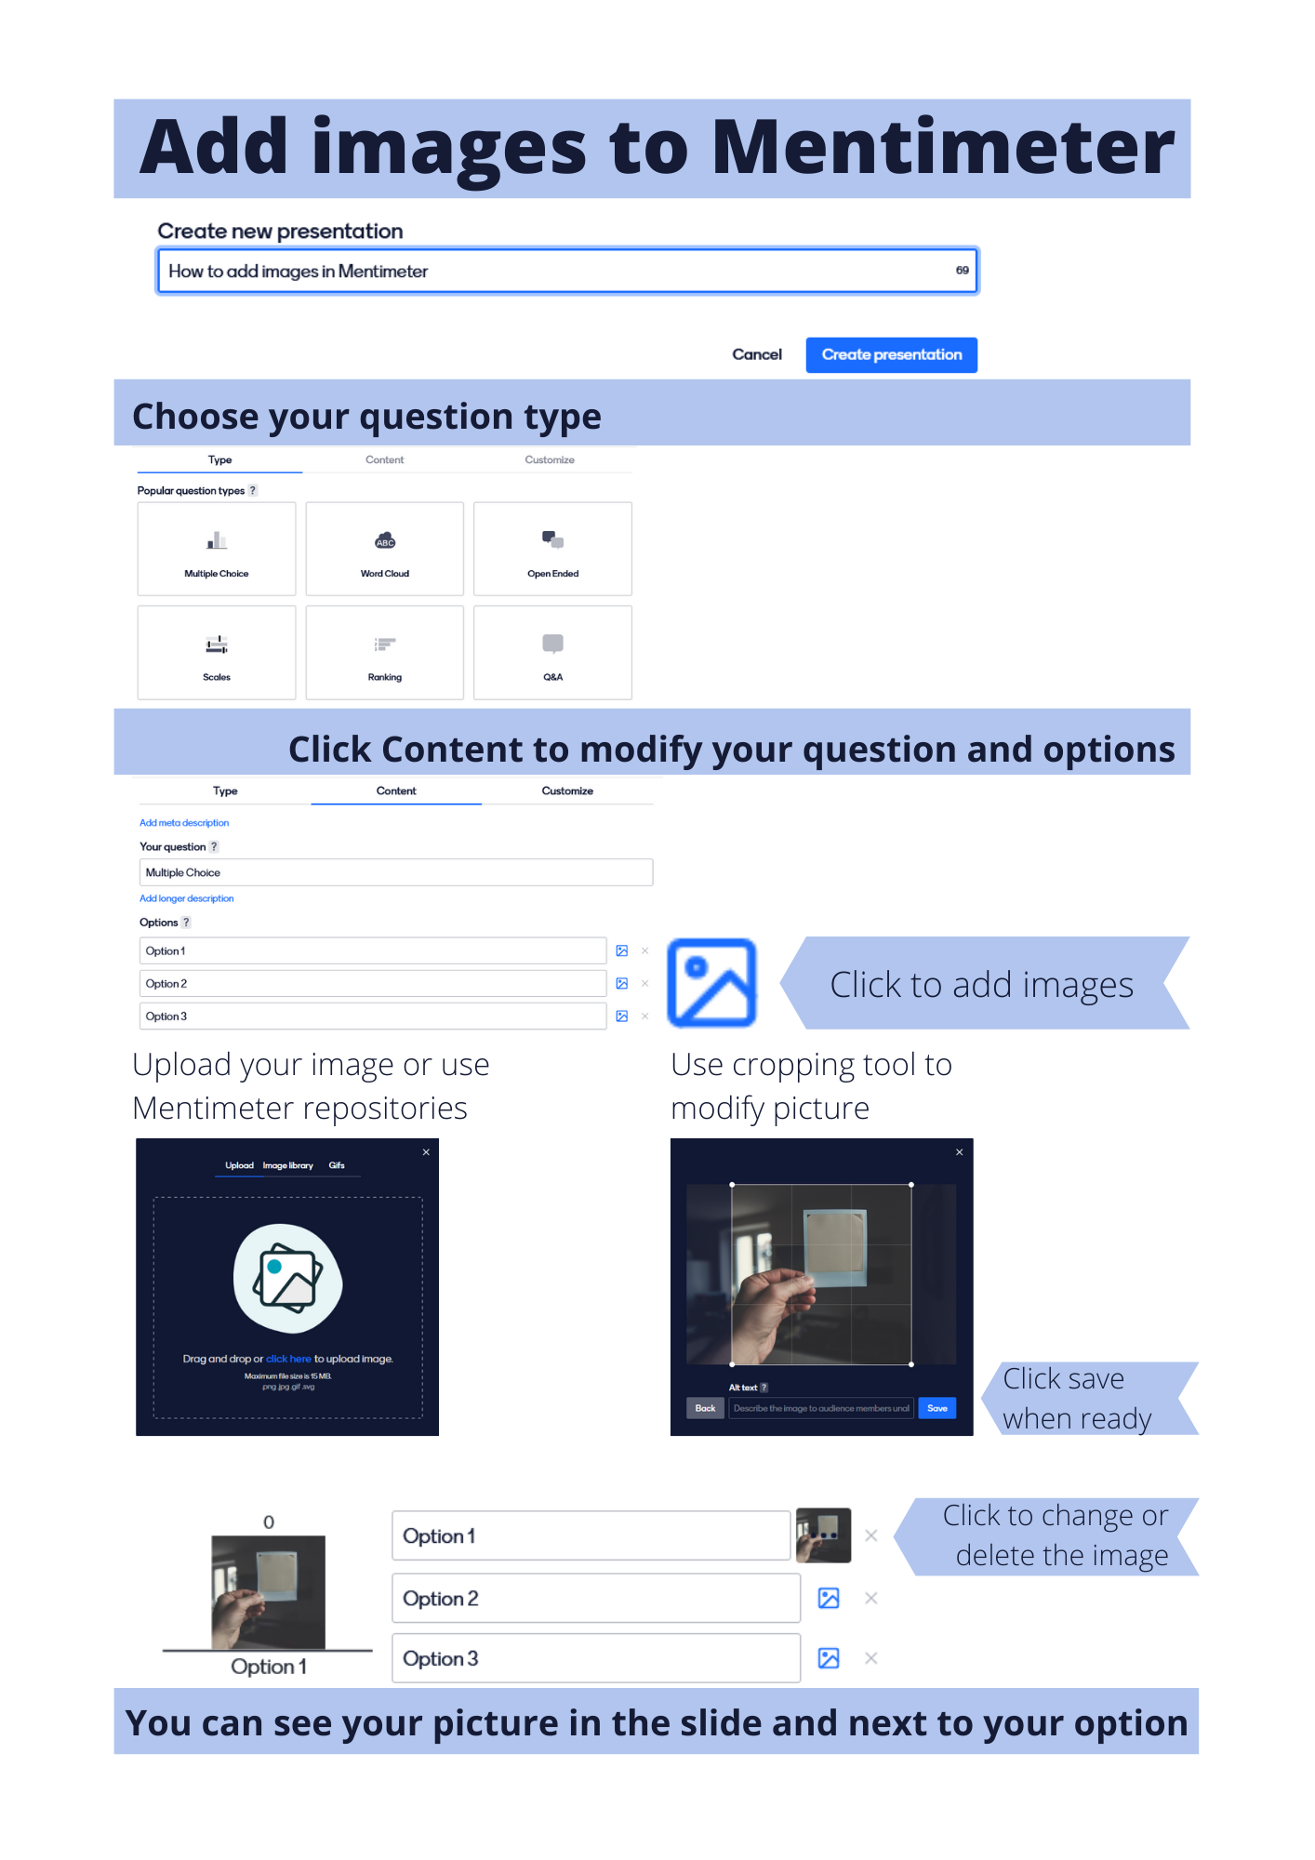
Instruction: Add images in Mentimeter

Slide 11
Sources
DigitALAD Handbook. N.d. Digital publication. https://digitaladproject.eu/images/handbook/en/index.html
Redecker, C. 2017. European Framework for the Digital Competence of Educators: DigCompEdu. Available at: https://joint-research-centre.ec.europa.eu/digcompedu_en Accessed 21.02.2022
ABEDiLi.2022. e-Pool. Website. https://sites.google.com/view/e-pool/home Accessed 21.02.2022.

