Slide 1
This work is licensed under a Creative Commons Attribution-NonCommercial 2.0 Generic (CC BY-NC 2.0) International License
Module 2 – Teaching and learning digital resources

Slide 3
VIRTUAL CLASSROOM
GROUND RULES
AUDIO
Mute yourself when not talking
REACTION
Use reactions to express yourself
LIVE
Ongoing comments and questions in chat
WEBCAM
Leave it on if possible

Slide 4
Ice-breaker
Who is my typical learner?
What skills do I want my learners to develop?

Slide 5
SAMR model
helps you to evaluate how you are using technology in your teaching practice.
Read more: Puentedura, R. R. (2015): SAMR: A Brief Introduction. Available at:
http://hippasus.com/rrpweblog/archives/2015/10/SAMR_ABriefIntro.pdf

Slide 6
The SAMR model
S A M R represents four different steps:
Substitution Augementation Modification Redifinition

Slide 7
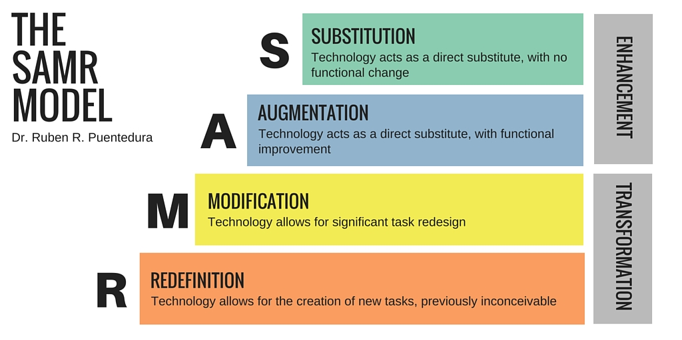
SAMR model
S A M R represents four different steps:
Substitution Augementation Modification Redifinition

Slide 8
SAMR model
Substitution
Technology acts as a direct substitute, with no functional change

Slide 9
SAMR model
Substitution
Technology acts as a direct substitute, with no functional change
Examples:
Distribute a written paper in a digital format
Learners use word instead of paper and pen
You use a presentation program (Flipgrid, Keynote, Powerpoint, Prezi, Slides) when you introduce new information

Slide 10
SAMR model
Augmentation
Technology acts as a direct substitute, with functional improvement

Slide 11
SAMR model
Augmentation
Technology acts as a direct substitute, with functional improvement
Examples:
You (or your students) include a link in your presentation.
You (or your students) support your presentation with a video clip

Slide 12
SAMR model
Modification
Technology allows for significant task redesign

Slide 13
SAMR model
Modification
Technology allows for significant task redesign
Example:
Your students use an LMS to cooperate and create a group response. They receive feedback from other learners in the group thanks to a discussion forum.

Slide 14
SAMR model
Redifinition
Technology allows for the creation of new tasks, previously inconceivable

Slide 15
SAMR model
Redifinition
Technology allows for the creation of new tasks, previously inconceivable
Example:
Your students could use technology to network with students in another part of the country or with students in other countries

Slide 16
Discussion
Give an example of teaching situations and digital media that can be used for substitution, augmentation, modification or redefinition.

Slide 17
Padlet
Padlet is a collaborative web platform where users can upload, organize, and share content to an online notice board.
Discussion
Do you use Padlet in your teaching?
What can your students learn if you use Padlet?
Is it an example of substitution, augmentation, modification or redefinition?

Slide 18
Mentimeter
Mentimeter is a web-based tool which enables creation of live polls, quizzes, word clouds, questions and answers.
Discussion
Do you use Mentimeter in your teaching?
What can your students learn if you use Mentimeter?
Is it an example of substitution, augmentation, modification or redefinition?

Slide 19
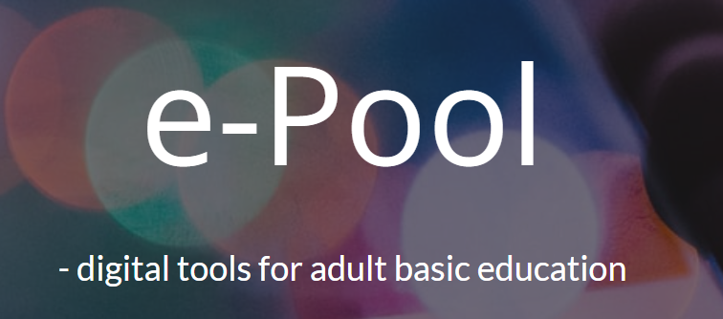
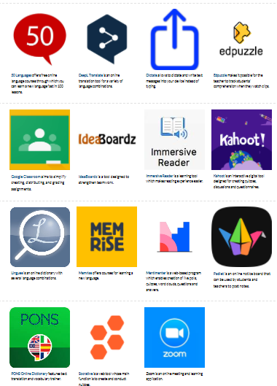
e-Pool
Go to “Recommended tools” in e-Pool.
Select one tool that you have used or want to use.
Read the description of the tool and try to answer these questions:
Have you used the tool in your teaching?
What do you think your students can learn if you use the tool?
Is it an example of substitution, augmentation, modification or redefinition?

Slide 20
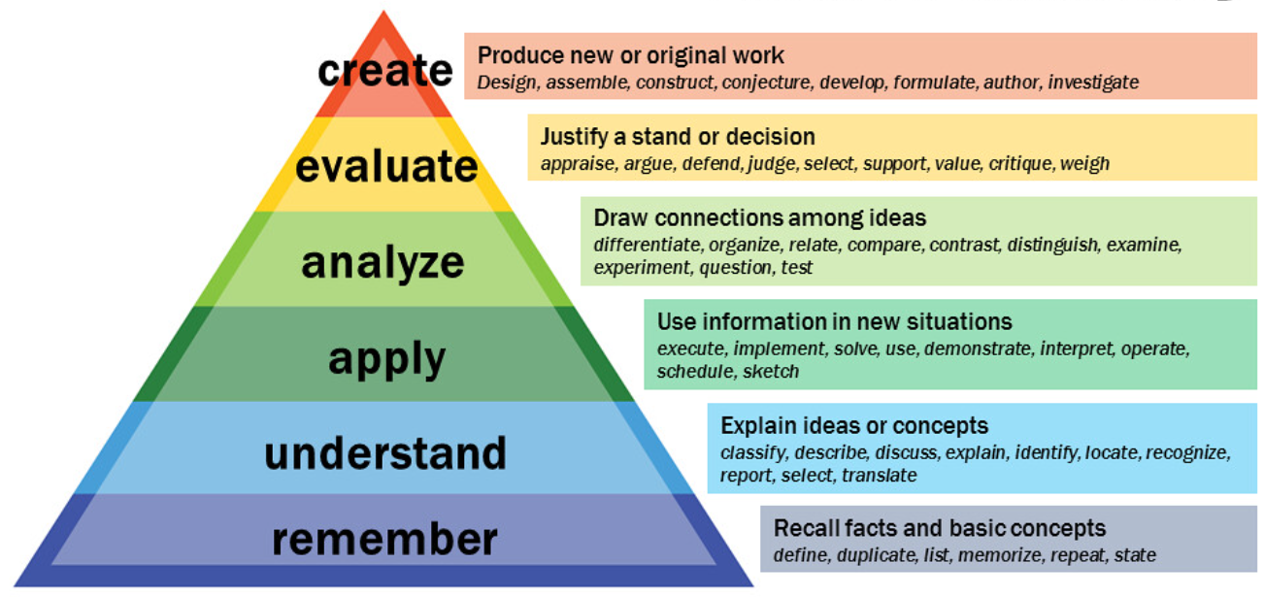
Bloom’s Taxonomy (revised)

Slide 21
Bloom’s Taxonomy (revised)
a classification of educational learning objectives
a hierarchy from concrete to more abstract and complex
Descriptive verbs have been created to align with levels of Bloom´s Taxonomy
models used for classification of educational learning objectives into levels of complexity and specificity

Slide 22
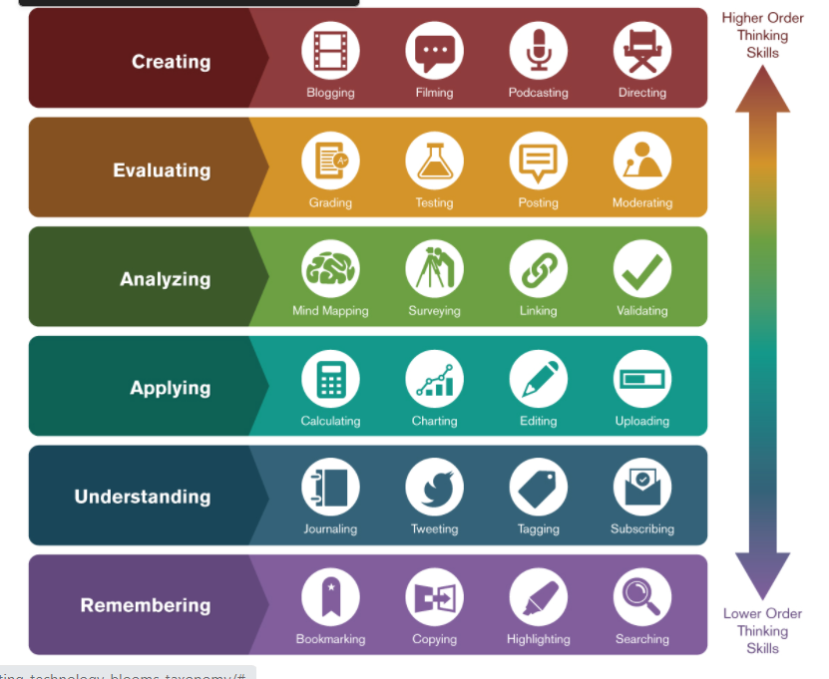
Bloom’s Taxonomy (revised)

Slide 23
The Padagogy Wheel
an attempt to bring together SAMR model, Bloom´s taxonomy and other domains of pedagogical thinking with apps and digital tools – in one chart
helps you think about how to use mobile apps in your teaching
the underlying principle: the pedagogy should determine the educational use of apps
Read more: Carrington, A. (2015). “It’s Not About The Apps, It’s About The Pedagogy”. Available at: https://www.teachthought.com/technology/the-padagogy-wheel

Slide 24
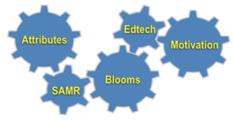
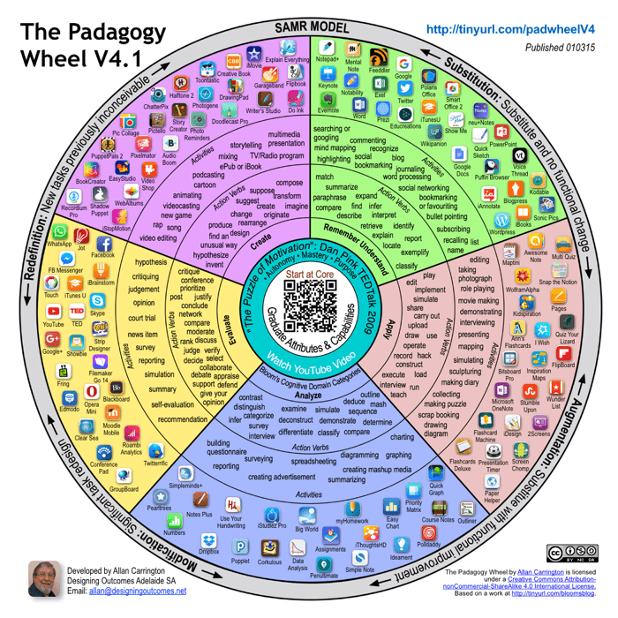
The Padagogy Wheel

Slide 25
The Padagogy Wheel

Slide 26
Post-course assignment
Formulate a learning objective and choose a digital tool that you want to try out.
Use the SAMR-model and Bloom’s Taxonomy and evaluate whether the digital tool adds any value to your teaching

Slide 27
Sources
Puentedura, R. R. (2015): SAMR: A Brief Introduction. Available at:
http://hippasus.com/rrpweblog/archives/2015/10/SAMR_ABriefIntro.pdf
Carrington, A. (2015). “It’s Not About The Apps, It’s About The Pedagogy”. Available at:
https://www.teachthought.com/technology/the-padagogy-wheel
Redecker, C. 2017. European Framework for the Digital Competence of Educators: Digcompedu.
Available at: https://joint-research-centre.ec.europa.eu/digcompedu_en Accessed 21.02.2022
ABEDiLi.2022. e-Pool. Website. Available at: https://sites.google.com/view/e-pool/home Accessed 21.02.2022.

