Slide 1
This work is licensed under a Creative Commons Attribution-NonCommercial 2.0 Generic (CC BY-NC 2.0) International License
Module 3 - Assessment and feedback

Slide 3
VIRTUAL CLASSROOM
GROUND RULES
AUDIO
Mute yourself when not talking
REACTION
Use reactions to express yourself
AUDIO
Mute yourself when not talking
REACTION
Use reactions to express yourself
LIVE
LIVE
Ongoing comments and questions in chat
WEBCAM
Leave it on if possible
Ongoing comments and questions in chat

Slide 4
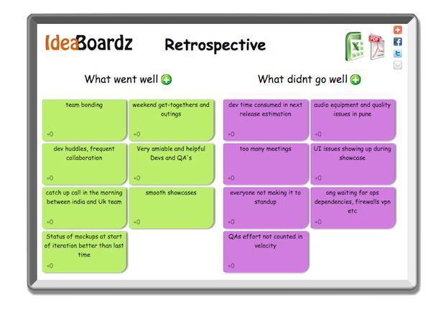
Ice-breaker!
Click into the Ideaboardz link in chat.
Describe the word ‘assessment’ in one word.

Slide 5
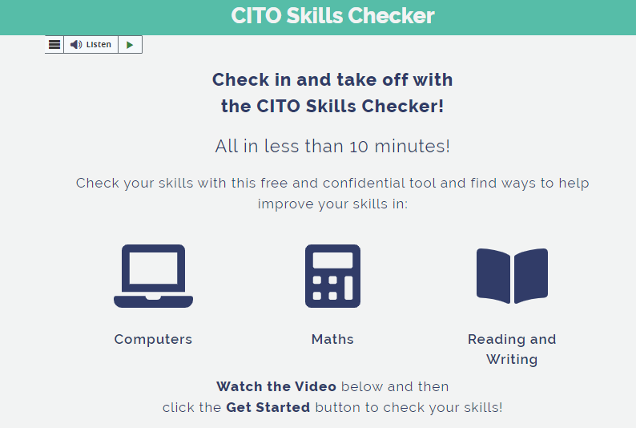
Self-Assessment Exercise
Try this free self-assessment quiz that is suited to basic skills learners.
https://citoproject.eu/

Slide 6
DigCompEdu Competency Levels

Slide 7
DigCompEdu Competency Levels
BEGINNER (A1)
Explorer (A2)
Making little use of digital technologies for assessment.
Making little use of digital data for monitoring progress.
Making little use of digital data for feedback and planning.
Integrating digital technologies into traditional assessment strategies.
Evaluating basic data on learner activity and performance.
Using digital technologies to inform feedback.

Slide 8
DigCompEdu Competency Levels
Integrator (B1)
Expert (B2)
Employing and modifying existing digital assessment tools and formats.
Evaluating a range of digital data to inform teaching.
Using digital technologies to provide feedback.
Strategically using a range of digital assessment formats.
Strategically employing the digital tool for data generation.
Using digital data to enhance the effectiveness of feedback and support.

Slide 9
DigCompEdu Competency Levels
Leader (C1)
Pioneer (C2)
Comprehensively and critically selecting, creating, and adapting digital assessment formats.
Using digital data to reflect on learning patterns and teaching strategies.
Using digital technologies to personalise feedback and support.
Developing innovative assessment formats, using digital technologies.
Innovating data generation and evaluation.
Using digital data to evaluate and improve teaching

Slide 10
How to make a ProProfs Quiz
Watch clip on how to make a ProProfs Quiz https://youtu.be/xX1BG3WwRvM
In break-out rooms, create a 3-question quiz with only 1 correct answer with the following statement ‘ProProfs quiz maker can be used to:’
Choose one person from your group to present the quiz to the group when you return from break-out rooms.

Slide 11
Post-course Assignment
Email will be sent to you:
Watch a 5 min video on Kahoot https://www.youtube.com/watch?v=kIdRFjMLR58
Create a 3-question quiz using Kahoot for pre-assessment for basic skills students. For example,’ Which sentence is spelled correctly?’
Complete the DigCompEdu self-assessment quiz.
Link: https://www.digcomptest.eu/index.php?pg=facaSeuTeste

Slide 12
References
Redecker, C. 2017. European Framework for the Digital Competence of Educators: DigCompEdu.
Available at: https://joint-research-centre.ec.europa.eu/digcompedu_en [Accessed 21.02.2022]
CITO.
Available at: https://citoproject.eu/ [Accessed 02/03/2022]

