Slide 1
This work is licensed under a Creative Commons Attribution-NonCommercial 2.0 Generic (CC BY-NC 2.0) International License
Module 5 - Supporting Basic Skills Through Technology

Slide 3
VIRTUAL CLASSROOM
GROUND RULES
AUDIO
Mute yourself when not talking
REACTION
Use reactions to express yourself
LIVE
Ongoing comments and questions in chat
WEBCAM
Leave it on if possible

Slide 4
Train the Trainer programme
Planning your teaching
Teaching and learning digital resources
Assesment and feedback
Accessibility and inclusion
Supporting basic literacy through technology
Self-development

Slide 5
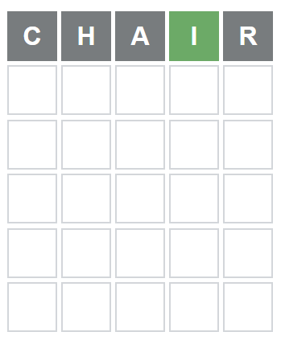
Icebreaker - Wordle
Go to nytimes.com
You have six tries to guess the five-letter Wordle of the day.
Type in your guess and submit your word by hitting the “enter” key on the Wordle keyboard.
Continue until you solve the Wordle or run out of guesses.
The colour of the tiles will change after you submit your word.
A yellow tile indicates that you picked the right letter, but it’s in the wrong spot.
The green tile indicates that you picked the right letter in the correct spot.
The grey tile indicates that the letter you picked is not included in the word at all.

Slide 6
How to actively engage learners - DigCompEdu framework

Slide 7
NALA guidelines for Basic Skills Educators
Aims to establish the right to develop literacy skills as a fundamental human right for adults who wish to improve their literacy and numeracy
Learner centered approach: focus lies on learner’s knowledge, skills and context
Core values are inclusivity, trust and confidentiality

Slide 8
4Cs
Critical thinking, communication, collaboration and creativity
Essential to preparing learners for the future
Provide a guide for educators when they are designing and developing their teaching and learning strategies

Slide 9
How could you use each one of these frameworks to improve your current practice?

Slide 10
Immersive reader – let’s try it out!

Slide 11
You can use:
OneNote
Word (desktop or online version)

Slide 13
Exploration on e-Pool
Critical thinking
Communication
Collaboration
Creativity
Choose one digital media from e-Pool for each of the 4Cs, that you could use in your practice with basic skills students.
Present your findings on Padlet.
Notes:
To padlet: ‘how I can use this resource to support my learners’.

Slide 14
Post course assignment
Choose one digital resource/tool in e-Pool to use with your learners to support their reading and writing skills.
Think about the needs and goals of your learners.
How can you plan your teaching session so that the learners can develop their 4C-skills?

Slide 15
Sources
Sources of images
https://www.google.com/url?sa=i&url=https%3A%2F%2Fwww.freetech4teachers.com%2F2018%2F01%2Fimmersive-reader-fantastic-addition-to.html&psig=AOvVaw1XeEhJa8WP5lhWvmal8TUX&ust=1645889164871000&source=images&cd=vfe&ved=0CAsQjRxqFwoTCIj-4oyVm_YCFQAAAAAdAAAAABAD
https://3.bp.blogspot.com/-ipmvXDTqTnE/Wku_QWZ79GI/AAAAAAABNc8/cDke-EusQ0A0cSNbRb1unkG6tPkgo88ZQCLcBGAs/s1600/immersive%2Breader%2B2.PNG
Source (content)
Redecker, C. 2017. European Framework for the Digital Competence of Educators: Digcompedu.
Available at: https://joint-research-centre.ec.europa.eu/digcompedu_en Accessed 21.02.2022

